Slide 1
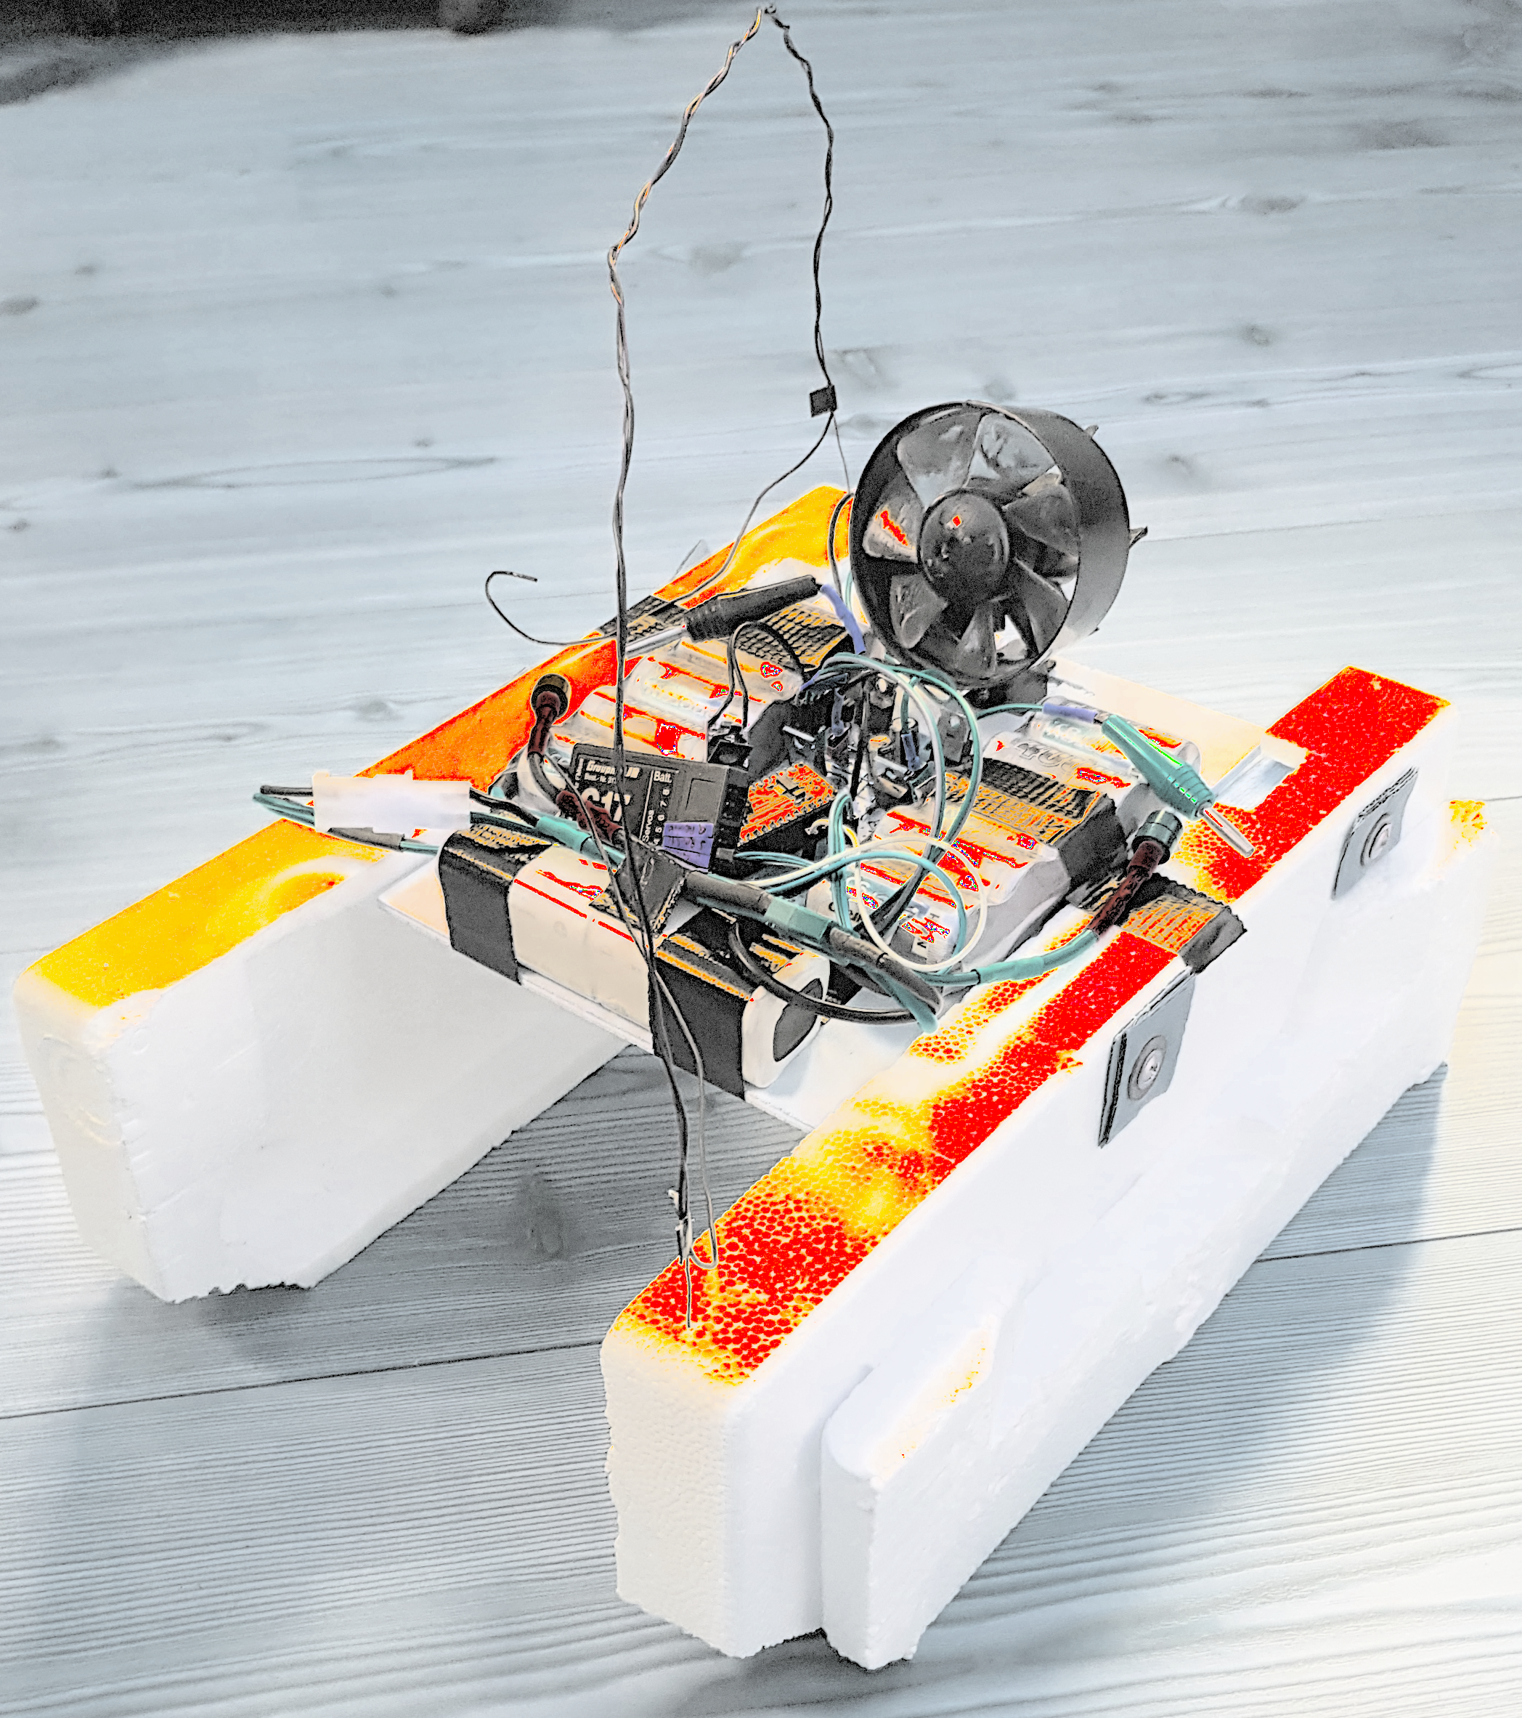
Remote controlled fan boat
Design & documentation
by Timo Benzel
Tübingen, Germany

Slide 2
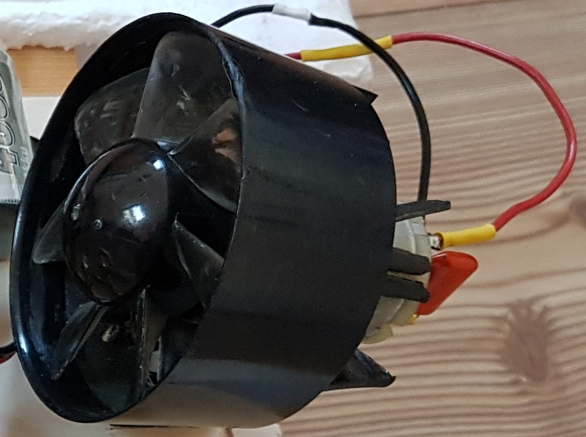
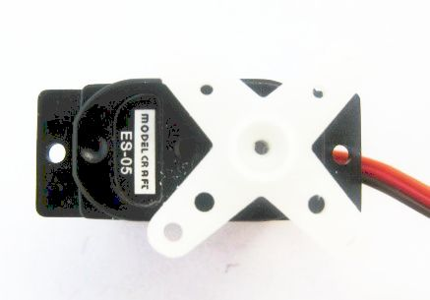
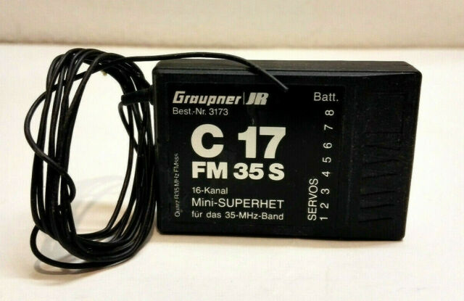
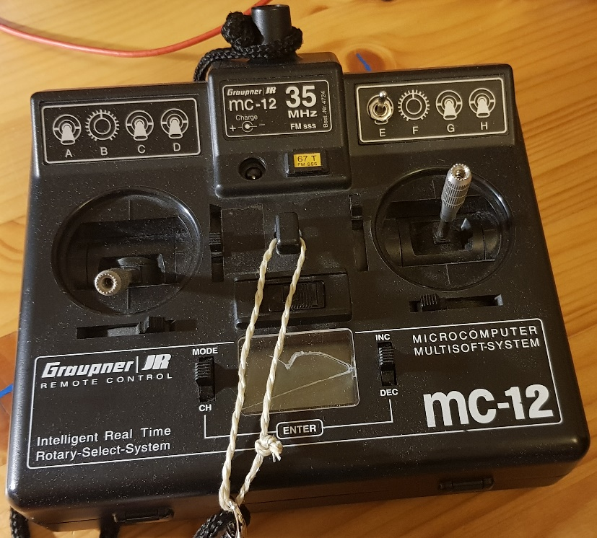
Project goal
Design a remote controlled (RC) boat using electronic trash such as:
an old hair dryer fan
a servo motor to rotate the fan for steering
two old 12V batteries
two boards of styrofoam
a 35MHz RC-sender and receiver from an old model airplane

Slide 3
Requirements
the boat shall be built out of used parts or already available parts (it is basically a trash boat)
the boat has to always stay afloat for all maneuvers
the boat has to be steerable within a range of at least 50m
the boats thrust shall be controllable via remote control
the boat shall not disintegrate itself
the boat shall be made as fast as possible with the available parts

Slide 4
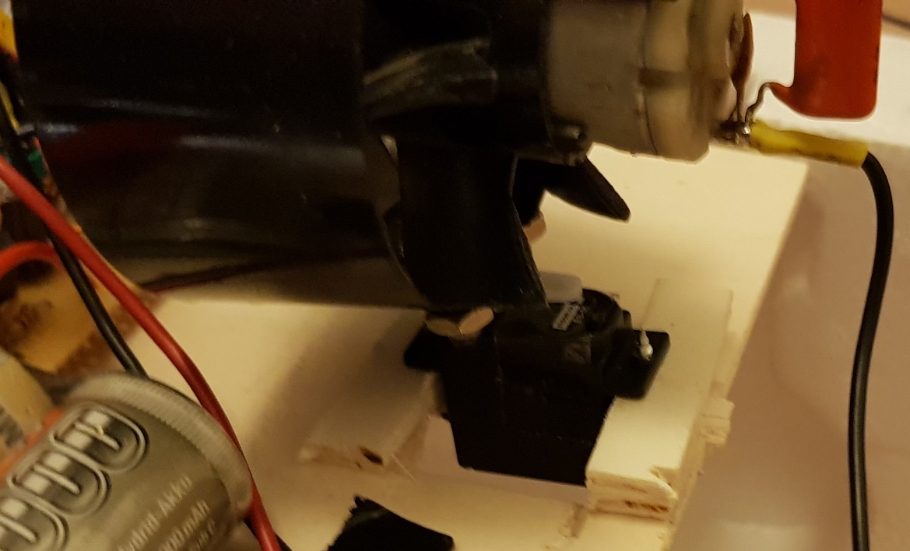
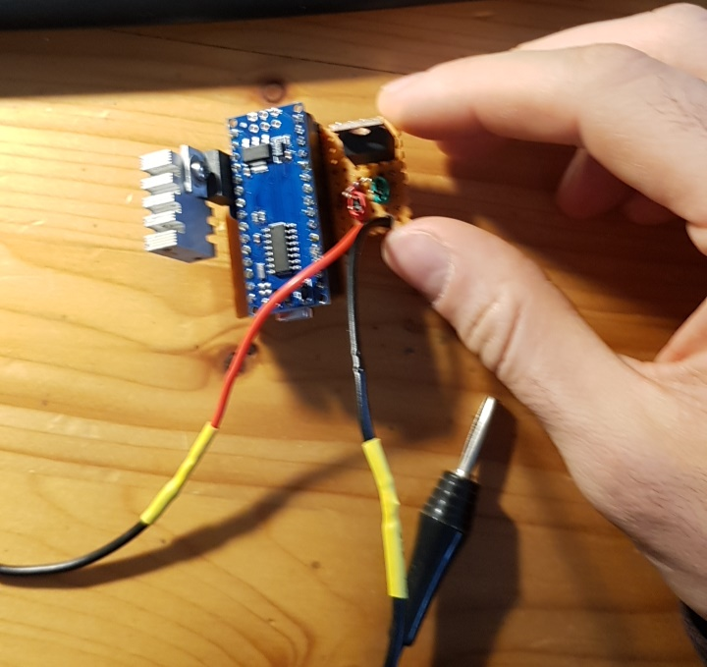
Version 1 – Goal
Use a primitive setup for the proof-of-concept
Use an emitter circuit to control the power to the motor with PWM
5V linear voltage regulator to power an Arduino Nano and the servo motor
screw the fan directly on the servo‘s plastic mounting cross (you will find a way ;) )

Slide 5
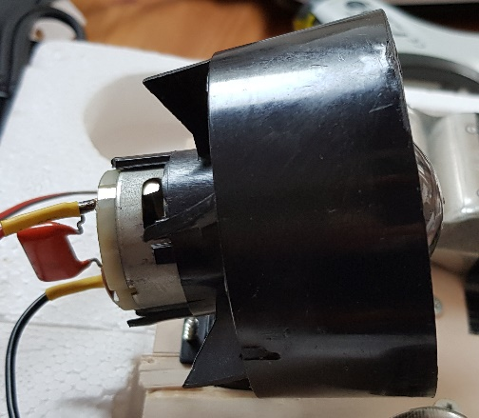
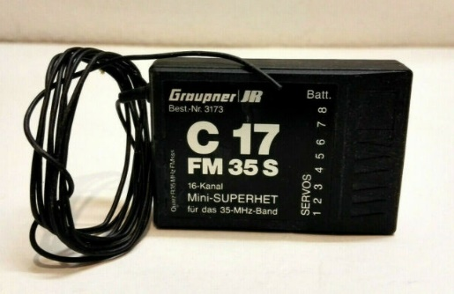

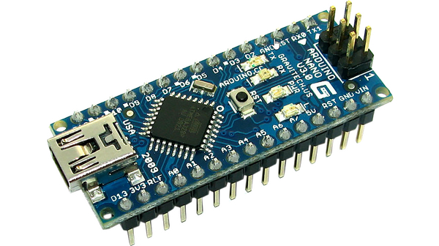
Version 1 – Parts used
old hair dryer fan
a servo motor to rotate the fan for steering
two old 12V batteries
two boards of styrofoam
a 35MHz RC-sender and receiver from an old model airplane
an Arduino Nano
5V linear voltage regulator
Power MOSFET with 5V Vds threshold

Slide 6
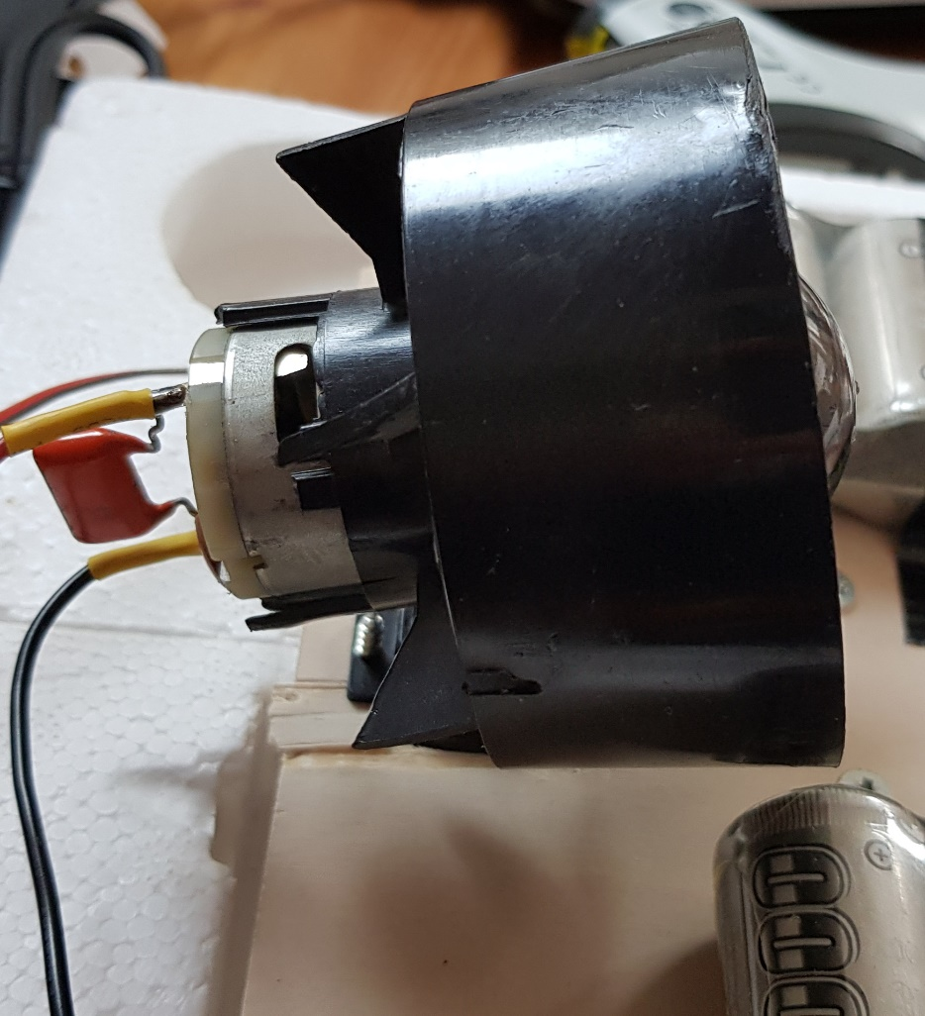

Version 1 – Build-up documentation
Start by cutting a hole in a small piece of wood/plywood on which the servo motor can be mounted
mount fan directly on servo using plastic screws from old eletronic devices
Mount the servo with the fan on top into hole

Slide 7
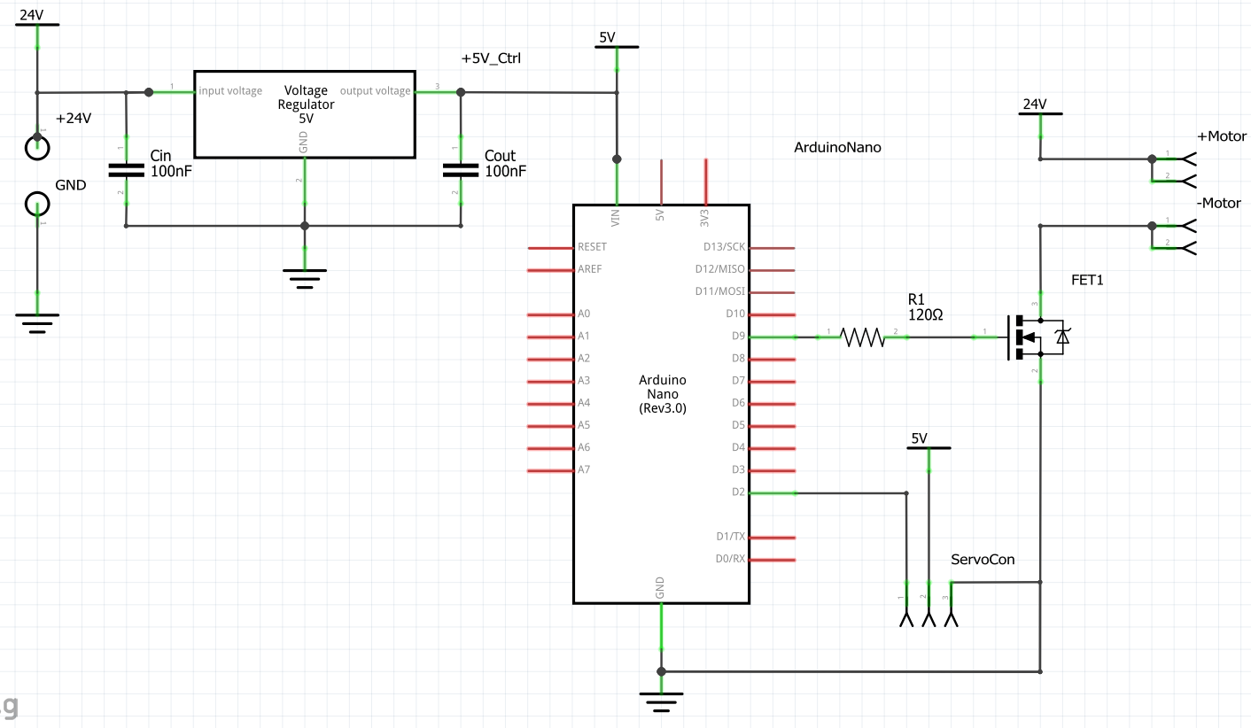
Version 1 – Build-up documentation
Connect two old 12V batteries in series in order for the output voltage to be high enough to generate enough fan speed (if you have different batteries just try out how many you need in order to get the voltage high enough for the fan to get up to speed)
Get a small piece of perfboard and put the components on there according to the schematic

Slide 8
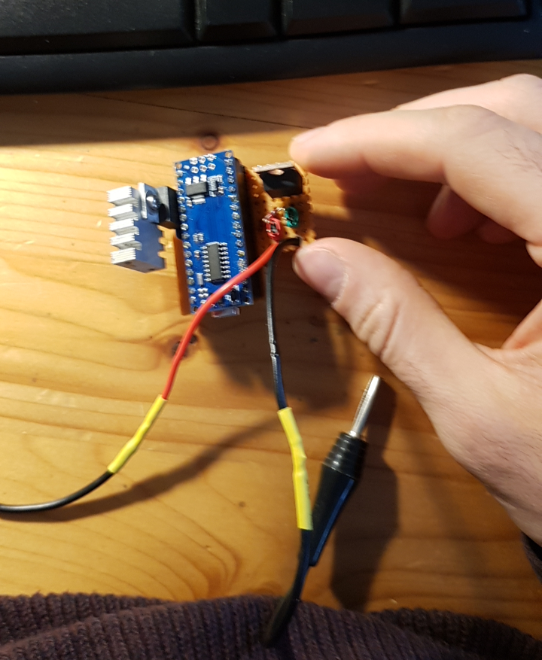
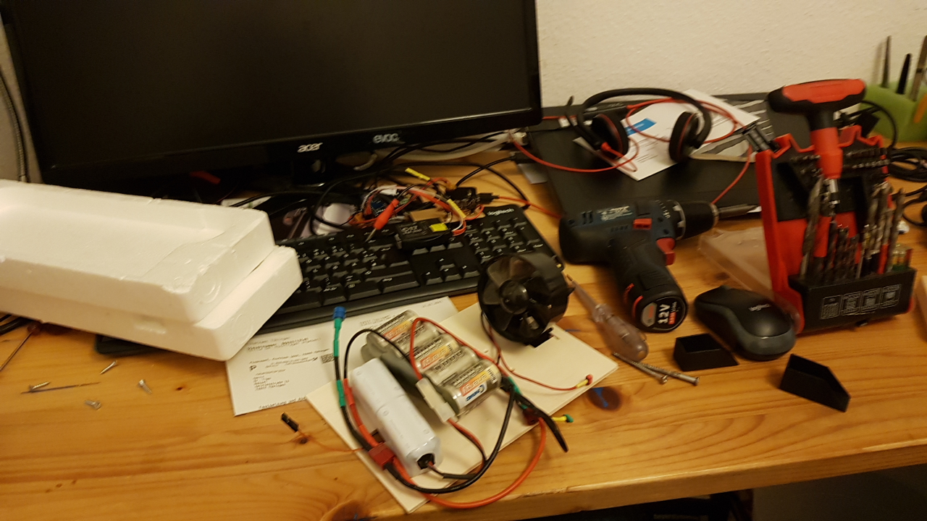
Version 1 – Build-up documentation

Slide 9
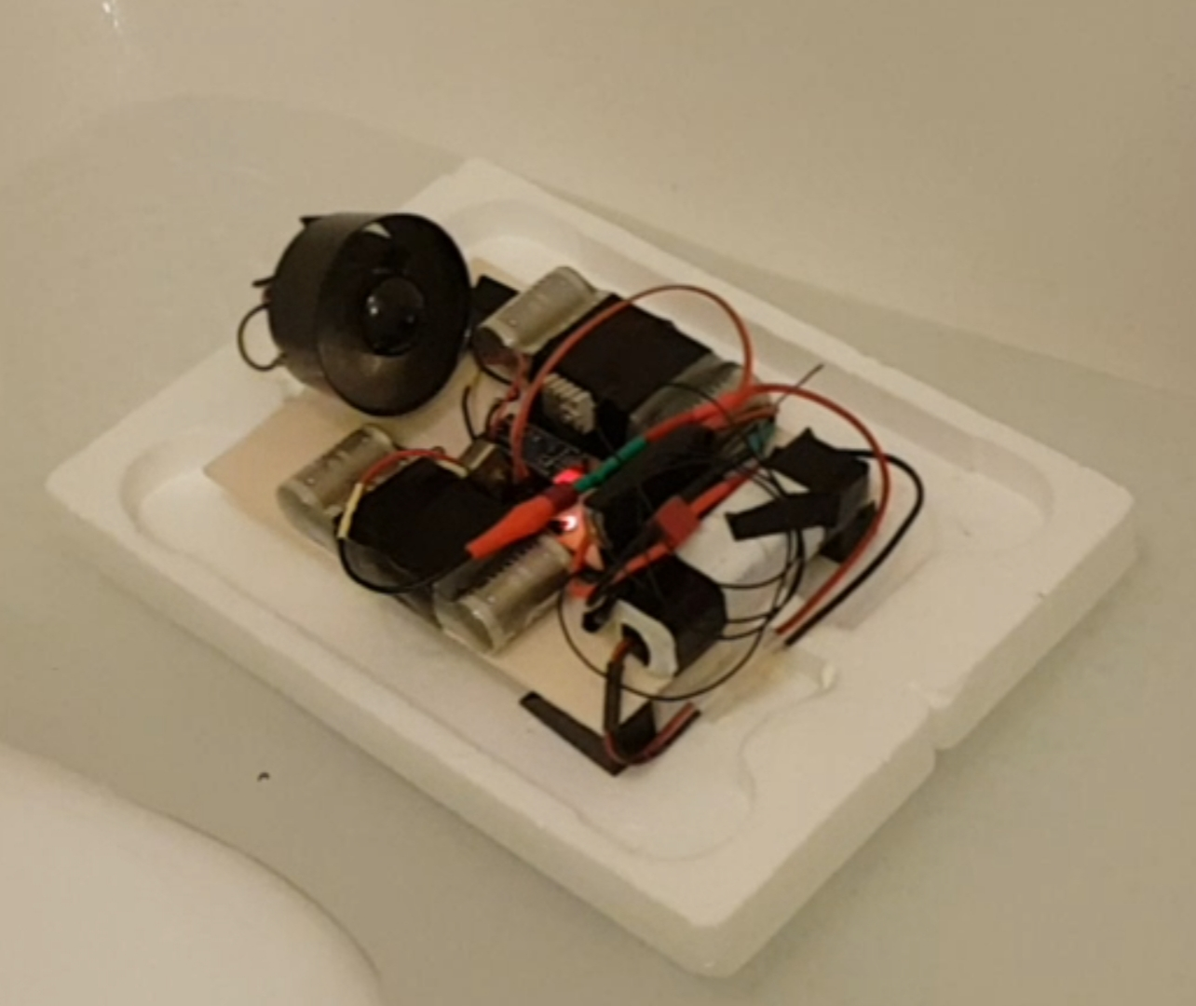
Version 1 – Build-up documentation
When you connect the plywood board to the styrofoam blocks always make sure you are using a clamping mechanism with tapping screws or use general purpose glue I clamped the two styrofoam pieces together with two sticks of wood through which i put wood screws
Careful: Test if your glue is corrosive to the styrofoam (e.g. superglue usually eat right thorugh styrofoam)
Version 1 taking a test swim in the bath tub

Slide 10

Version 1 – Validation
The boat stays afloat → requirement fullfilled
Boat is steerable and thrust controllable
The boat is built out of old/used parts

Slide 11
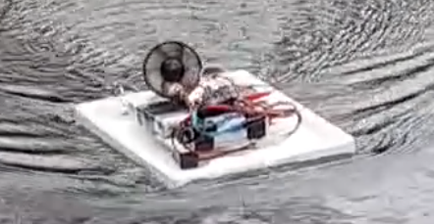
Version 1 – Validation
the boats crosssection was quite large and non-hydrodynamically shaped, so the bow wave was especially prominent
which caused
increased drag
water spilling into the cavity of the styrofoam blocks underneath the electronics (not too bad, but not ok)
smaller max. velocity (ironically especially when thrust is high)

Slide 12
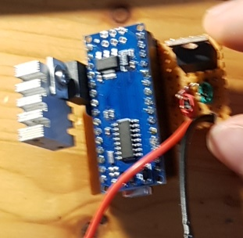
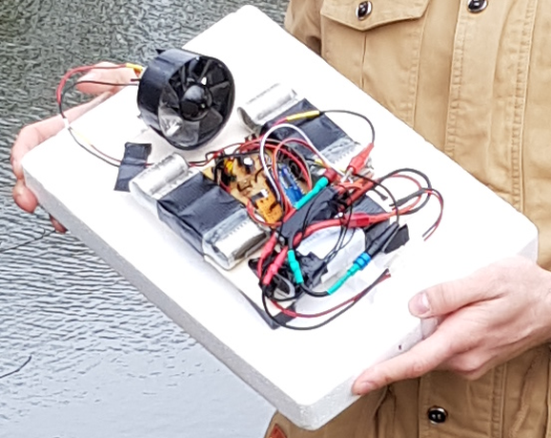
Version 1 – Validation
The 5V linear voltage regulator reached >60°C even with a huge heat sink, especially when the servo was used a lot This temperature was considered to be too high
In version 1 the antenna was wound up into a ring which decreased the range of good reception to only about 10m; beyond this range the controls would start acting up

Slide 13
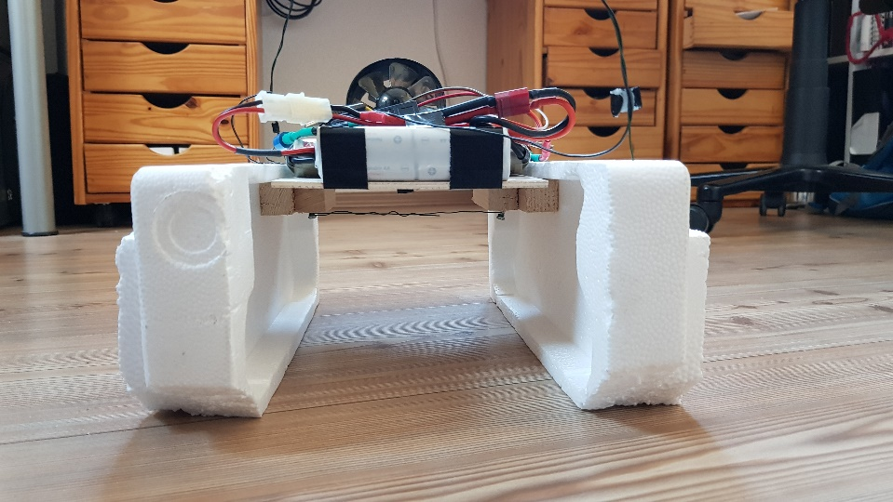
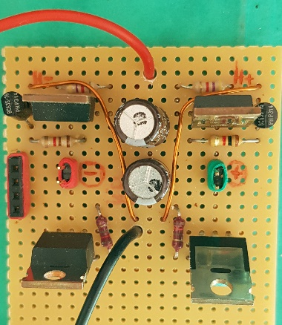
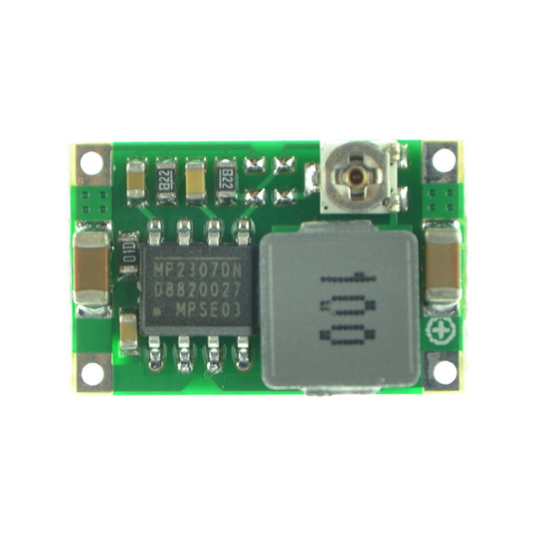
Version 2 – Goals
This version needs to have the ability to generate reverse thrust by
using a full bridge power stage design
Sensing another channel from the receiver telling the arduino to control the powerstage in forward or in reverse
Improvements on the previous design:
less drag due to smaller crosssection due to the katamaran design
instead of the use a full-bridge inverter design to create the possiblity of inverting the motor voltages and thus the capability to reverse thrust
replace the linear voltage regulator with a DC-DC step-down converter to generate the 5V with fewer losses and thus smaller temperatures

Slide 14
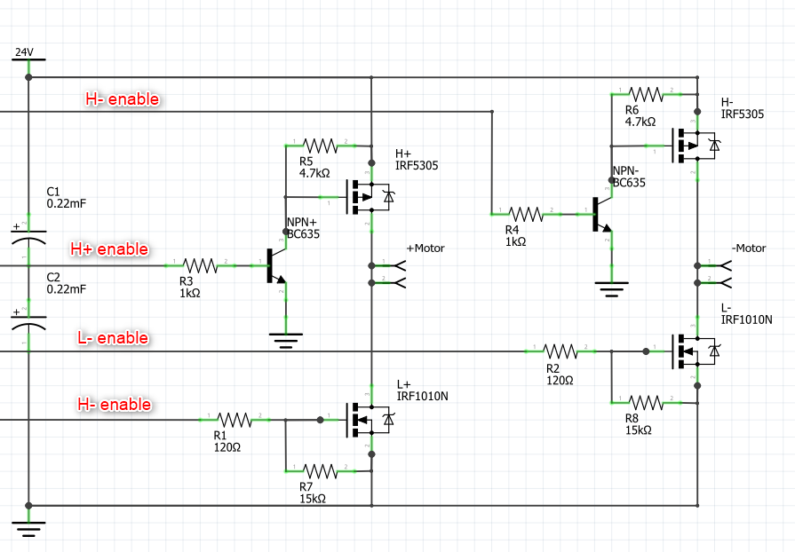
Version 2 – Build-up documentation
The new full-bridge powerstage consists of 4 MOSFETs
The highside (H+/H-) MOSFETs are used as switches via a level shifter with an NPN transistor (see also: http://electronics-diy.com/electronic_schematic.php?id=1012)
The lowside MOSFETs are controlled directly with a PWM signal to control the motor power input
for power control the lowsides are used because the lowside FETs are n-channel MOSFETs which switch much faster than the p-channel highside MOSFETs (probably due to my poor circuit design :D)

Slide 15
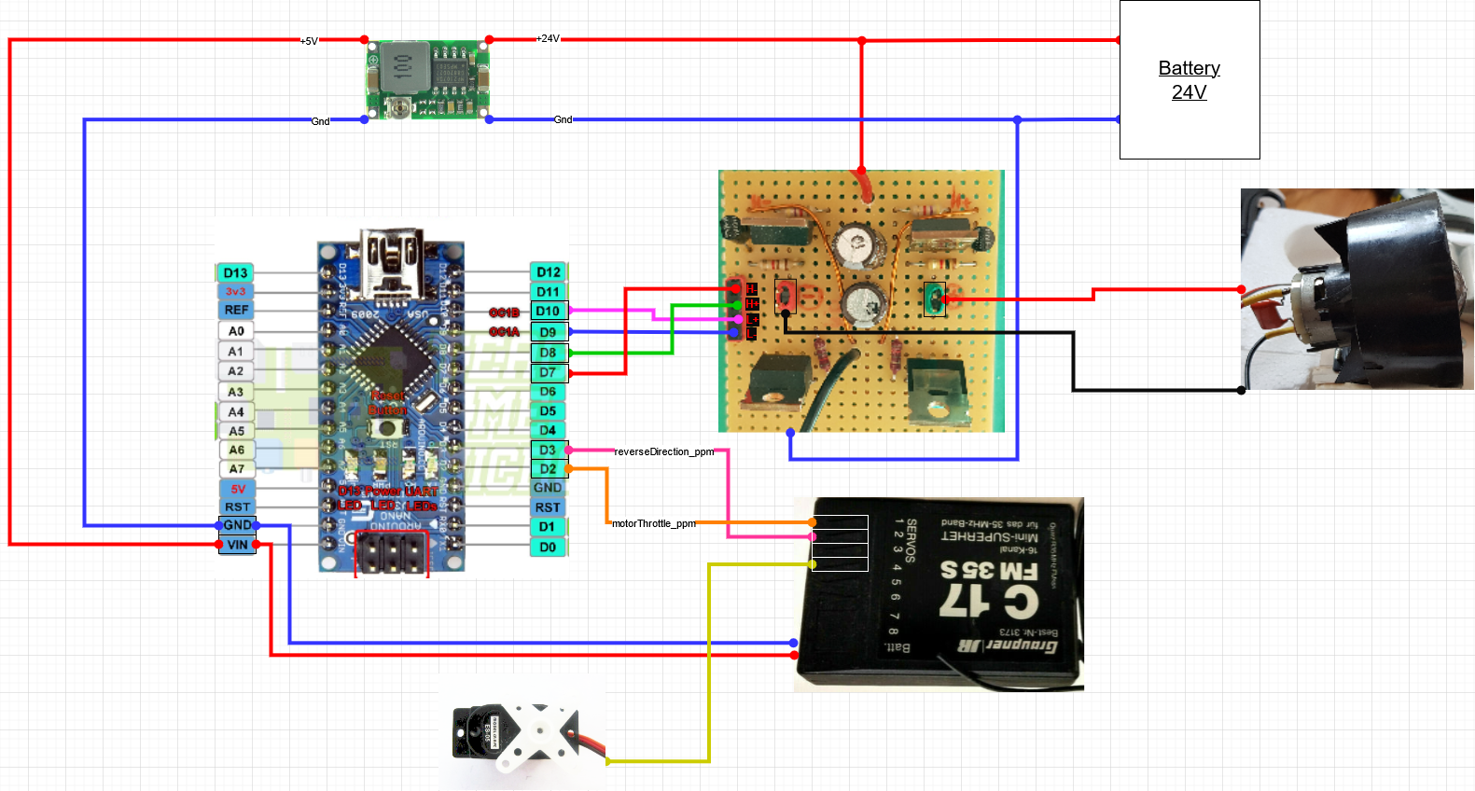
Version 2 – Build-up documentation
The overall wiring of version 2

Slide 16
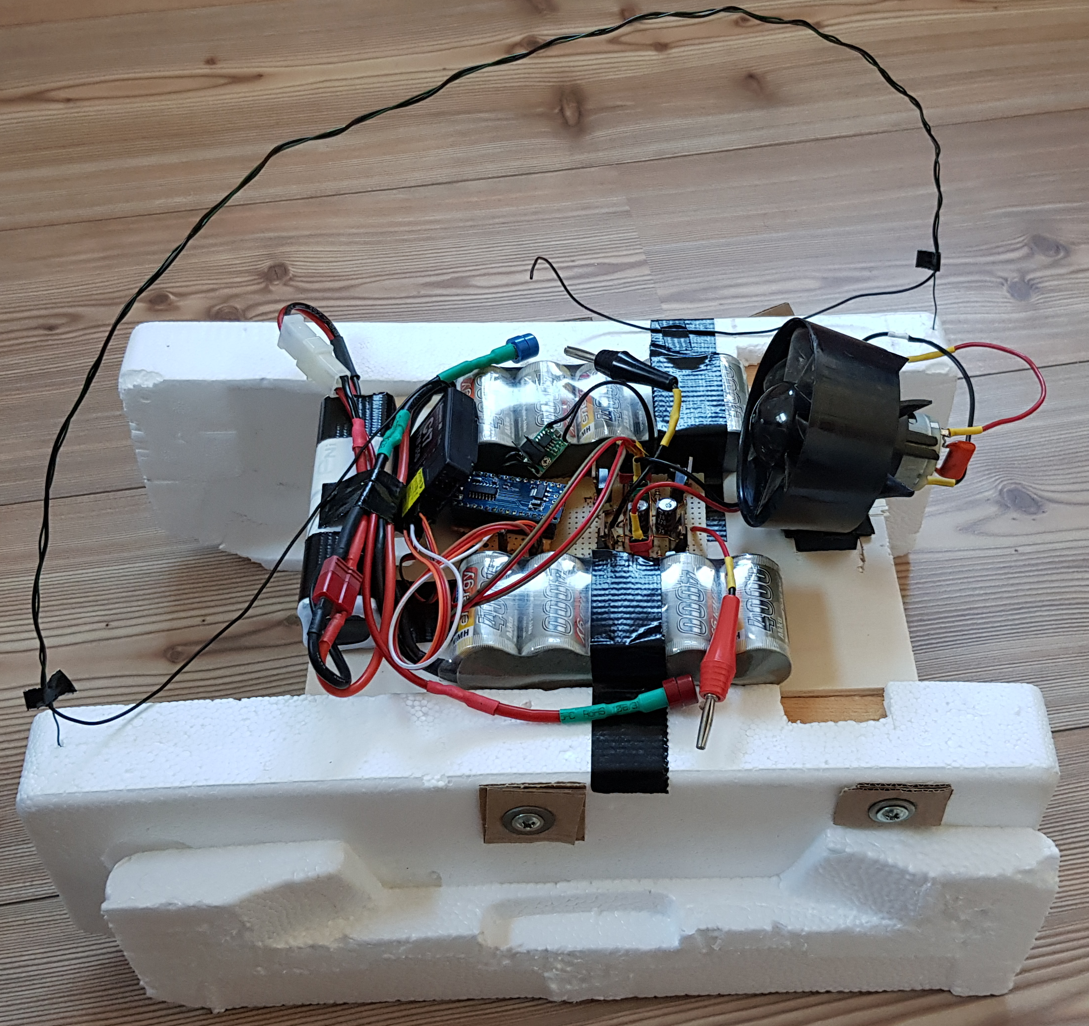
Version 2 – Build-up documentation
The plywood board was screwed onto two wooden bars, one on each side
The wooden bars would be pushed against the styrofoam with screws supported by washers and cardboard on the ofter side of the foam block
The antenna would be would around a thick wire fixed to the styrofoam to maximize ist straight length to increase reception

Slide 17
Version 2 – Build-up documentation
Usually these hair dryer fans work with AC voltage, which is why they have a rectifier attached between the power supply and the connectors to the brushes → now that we want to apply negative voltages to the motor, we need to remove the rectifier But: leave the intermediate circuit capcitor on there. It makes sure, that the high voltage sparks from the brushes does not affect your power electronics too much

Slide 18
Version 2 – Validation
The range is much larger now > 20m → the straightened antenna design works well
the fan was facing upward which caused a torque pushing down the bow of the boat which still caused:
increased drag
smaller max. velocity (ironically especially
less thrust being directed forward but downward
Upward thrust
Forward thrust
thrust
fan
Torque due to upward thrust
COM

Slide 19
Version 2 – Validation
The RC receiver got damaged after the validation at home (reason unknown)
Symptom: All control signals behaved erratic
Root cause lies in the receiver
Origin might be the voltage harmonics in the DC-DC converter, that might have damaged the receiver → 35 MHz RC system needs to be replaced with 2,4 Ghz system (more robust when it comes to disturbances)

Slide 20
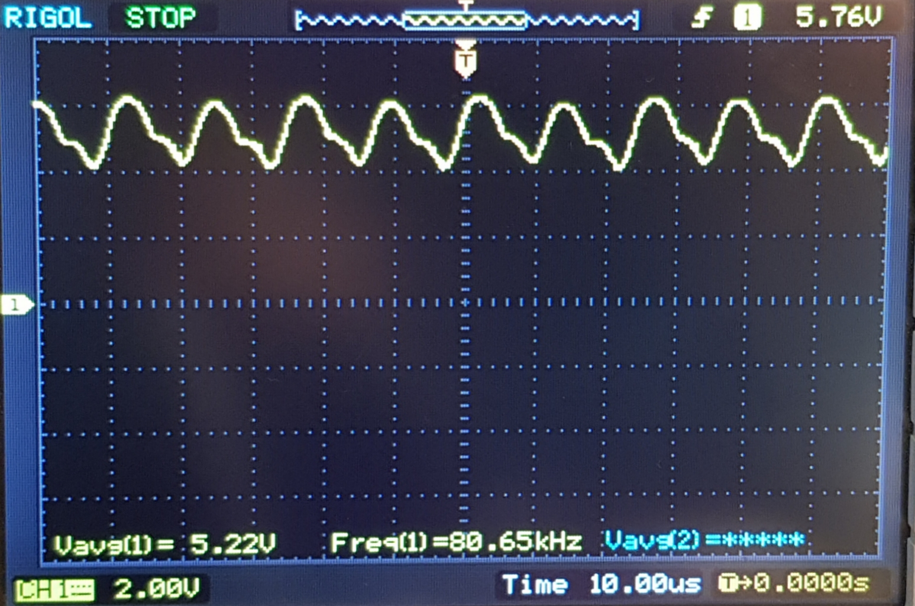
Version 2 – Validation
Power supply output filter needs to be installed because the 5V voltage output of the DC-DC converter ripples dramatically with a 2Vpp value at 80 kHz this behavior might damage other components as well

Slide 21
Version 2 – Validation
There are still issues with the forward-backward direction
When the sender is put into „backward“ and then the receiver is turned on the motor does not react at all → the direction state was undefined
this issue needs to be fixed

Slide 22
Version 3 – Goals
this version needs to have the fan tilted downwards, such that the bow is rising out of the water
power supply output filter needs to be installed because the voltage ripples of 2Vpp are too large
replace the 35 MHz RC system with 2,4 GHz system

Slide 23
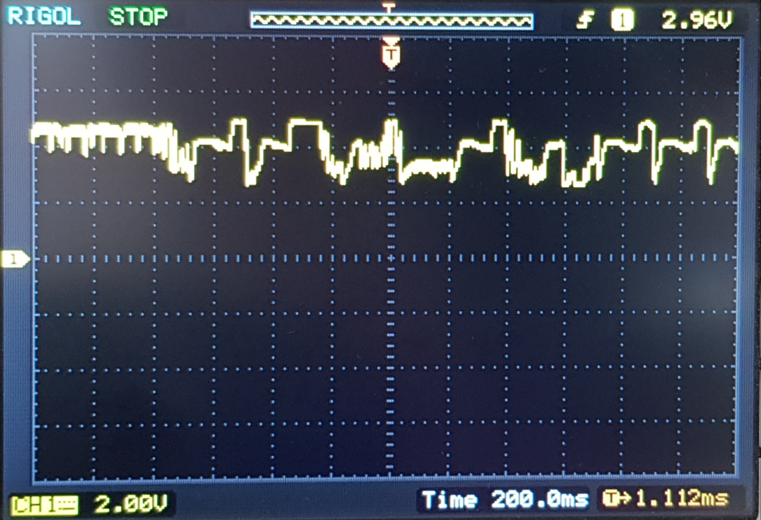
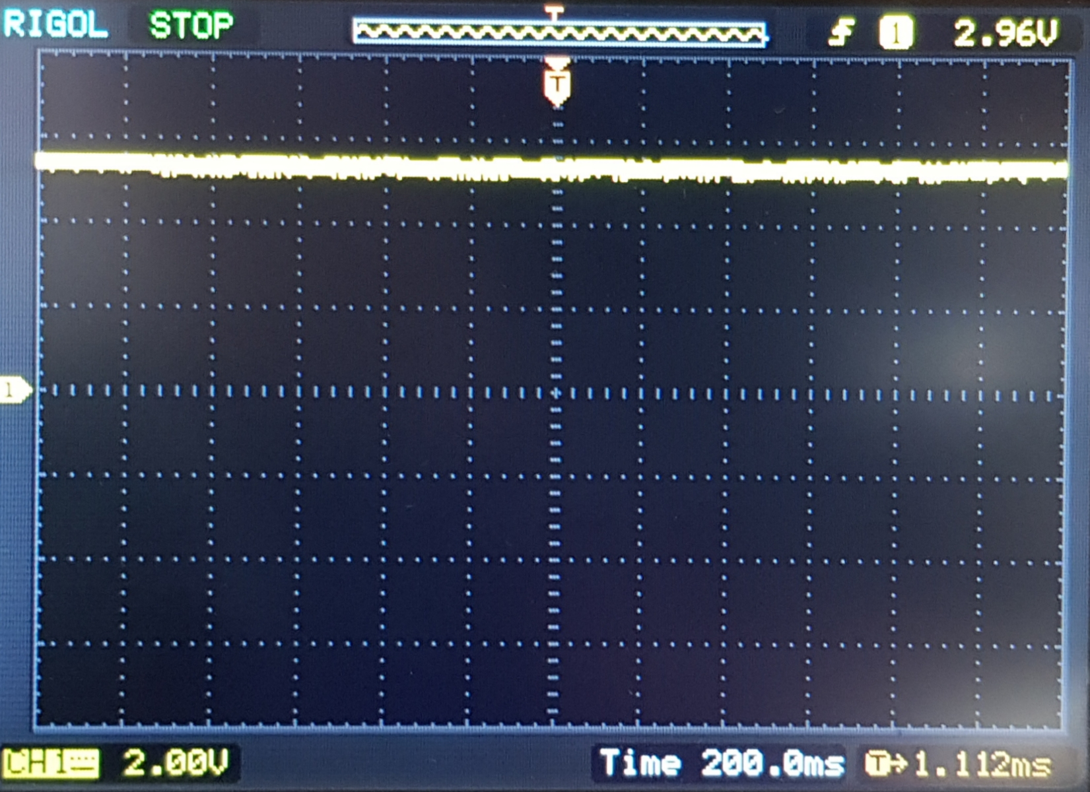
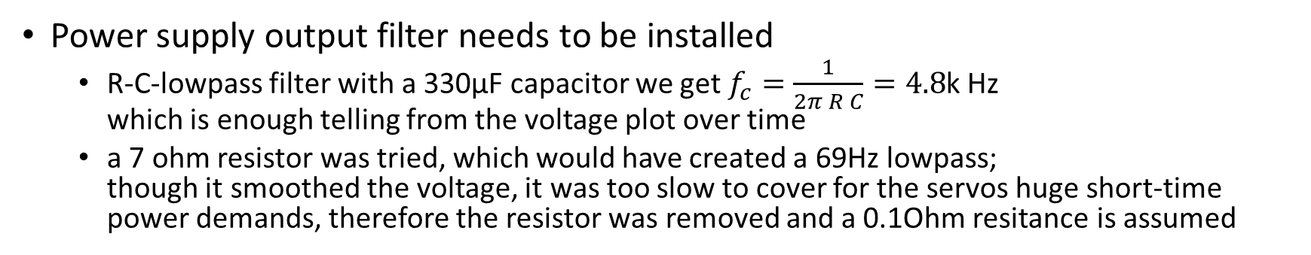
Version 3 – Build-up
Power supply output filter needs to be installed
R-C-lowpass filter with a 330µF capacitor we get $f_{c}=\frac{1}{2π R C}=4.8$k Hz which is enough telling from the voltage plot over time
a 7 ohm resistor was tried, which would have created a 69Hz lowpass; though it smoothed the voltage, it was too slow to cover for the servos huge short-time power demands, therefore the resistor was removed and a 0.1Ohm resitance is assumed
Raw DC-DC converter output
69 Hz-lowpass under varying load
4.8kHz-lowpass
under varying load

Slide 24
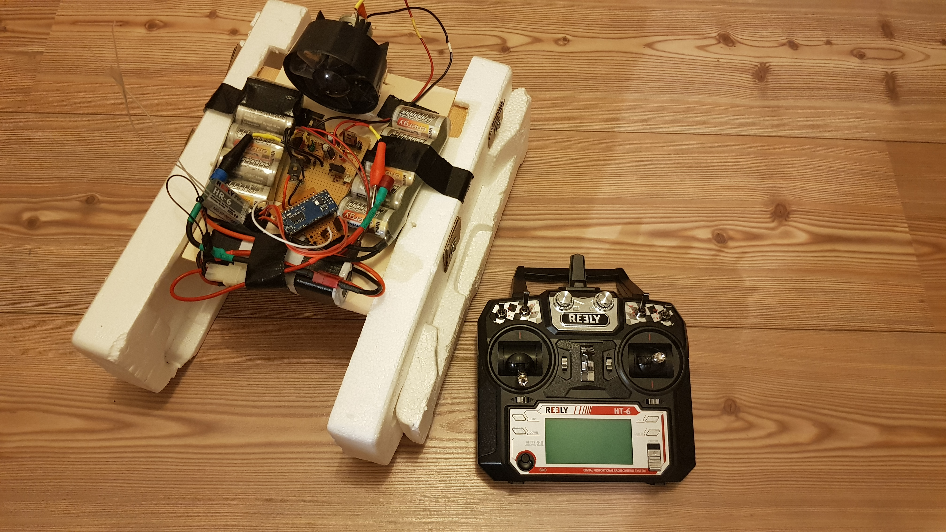
Version 3 – Build-up
Neues System consists of
2.4 GHz sender and receiver
5V-DC-DC converter output capacitor (330µF)
SW bugfix concerning fwd/bwd direction issue

Slide 25
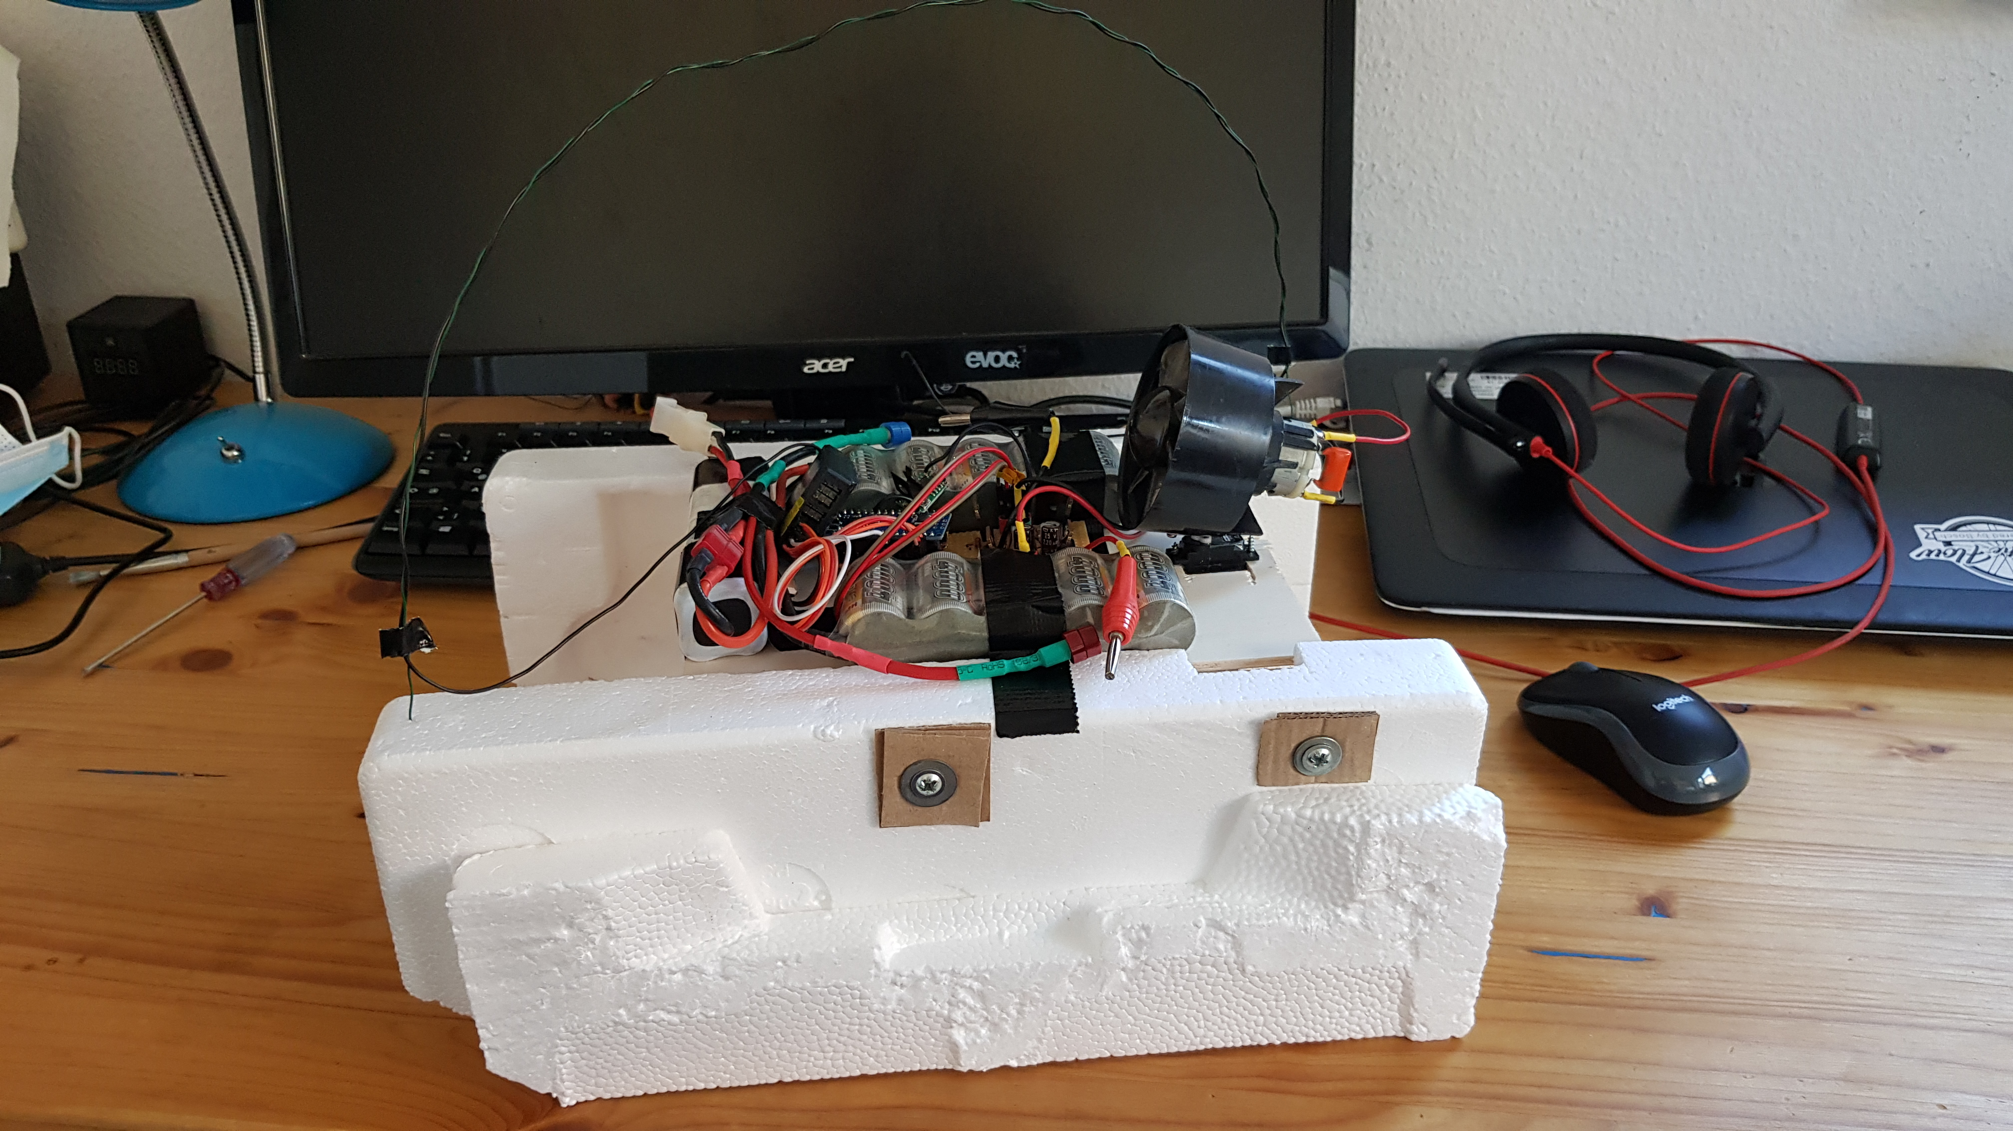
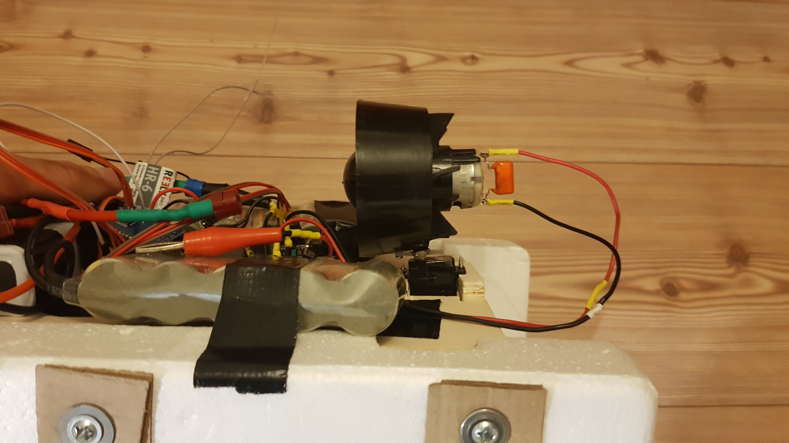
Version 3 – Build-up
old
New version also has an decrease fan tilt angle
Old: ~20°
New: ~0°
new

Slide 26
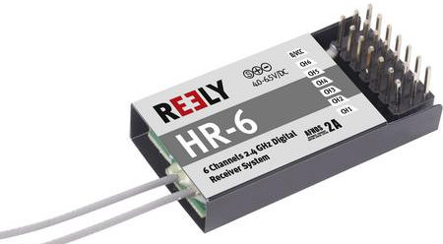
Version 3 – Build-up
The new RC system has two freely programmable channels you can assign switches to
I chose to put switch A on receiver channel 5
I connected channel 5 with my previous input and tuned the fwd/bwd-switch threshold to 1500µs because the switch generates a PPM signal on channel 5 that goes from OFF-1000µs to ON-2000µs

Slide 27
Version 3 – Validation
thrust
fan
Boat is not tilting forward as much but still enough to cause a lot of drag
the tilting lever has decreased
reason for tilting:
fan being high above the batteries and
especially with the COM begin high above the water line the boat
the batteries are unnecessarily heavy
currently: 21,6V, 18 NiMH cells with 3000mAh, weighing 940 g
Option 1: AAA NiMH → 18 AAA cells with 800mAh weighing 15g x 18 = 270g with wires and harness it would be around 300g → less than 1/3 with AAA batteries (amount of stored energy goes down the same factor)
Option 2: LiPo battery 6s with 22,2V and 3300mAh weighing 513 g
Torque due to upward thrust
COM

Slide 28

Version 4 - Goals
design a completely new frame
3d printed single shell in a similar shape as a real airboat →
Fan needs to be lower than before
Option 1: switch to a BLDC fan with a servo controlling fins behind the fan
Option 2: stay with the DC fan and get the best out of it

